Slide 1
Deriving Intrinsic Images from Image Sequences
Yair Weiss
Mohit Gupta
04/21/2006
Advanced Perception

Slide 2
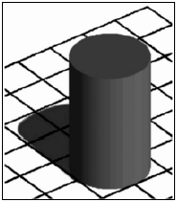
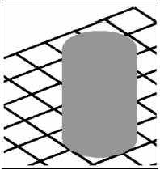
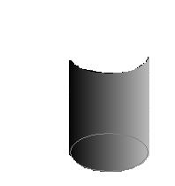
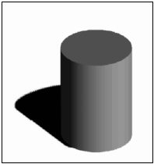

Intrinsic Scene Characteristics
Introduced by Barrow and Tanenbaum, 1978
Motivation: Early visual system decomposes image into ‘intrinsic’ properties
Input Image
Reflectance
Orientation
Illumination
Distance

Slide 3
Intrinsic Images
Input = Reflectance x Illumination
Mid-Level description of scenes
  Information about intrinsic scene properties
  Falls short of a full 3D description

Slide 4
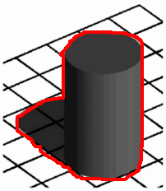
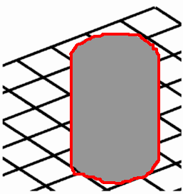
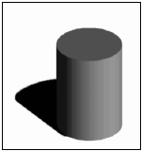
Motivation
Information about scene properties: prior for visual inference tasks
Segmentation: Invariant to illumination
Original
Reflectance
Illumination

Slide 5
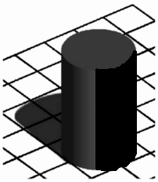


Motivation
Information about scene properties: prior for visual inference tasks
Shape from Shading: Invariant to reflectance
Original
Reflectance
Illumination

Slide 6
Problem Definition
Given I, solve for L and R such that
I(x,y) = L(x,y) * R(x,y)
I = Input Image
L = Illumination Image
R = Reflectance Image

Slide 7

Problem Definition
(disturbed ) This is preposterous!!
You can’t possibly solve this !!
Given I, solve for L and R such that
I(x,y) = L(x,y) * R(x,y)
Classical Ill Posed Problem:
# Unknowns = 2 * # Equations
Dr. Math

Slide 8

Problem Definition
(disturbed ) This is preposterous!!
You can’t possibly solve this !!
Given I, solve for L and R such that
I(x,y) = L(x,y) * R(x,y)
Hey doc, Don’t PANIC
These pixels ‘hang out together’ a lot
Classical Ill Posed Problem:
# Unknowns = 2 * # Equations
Dr. Math
Exploit ‘structure’ in the images to reduce the no. of unknowns !
Mohit

Slide 9
Previous Work
Retinex Algorithm [Land and McCann]
    Reflectance image piecewise constant
Illumination is attached shadows (photometric sterero)
    L(x,y,t) = N(x,y) . S(t)
Illumination images related by a scalar
    L(x,y,t) = α(t) * L(x,y)

Slide 10
Previous Work
Retinex Algorithm [Land and McCann]
    Reflectance image piecewise constant
Illumination is attached shadows (photometric sterero)
    L(x,y,t) = N(x,y) * S(t)
Illumination images related by a scalar
    L(x,y,t) = α(t) * L(x,y)
All exploit temporal or spatial structure
in the images to reduce the no. of unknowns !

Slide 11
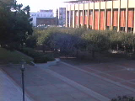
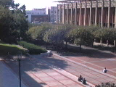
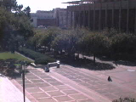
Cut to the present…
This paper relies on temporal structure
  R(x,y,t) = R(x,y)
Motivation
  Lot of web-cam images
  Stationary camera, reflectance doesn’t change

Slide 12
Cut to the present…
This paper relies on temporal structure
  R(x,y,t) = R(x,y)
I(x,y,t) = R(x,y) * L(x,y,t)
T equations, T+1 unknowns
Still an Ill-Posed Problem !!
Motivation
  Lot of web-cam images
  Stationary camera, reflectance doesn’t change

Slide 13
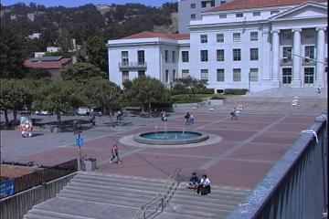
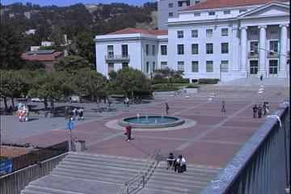

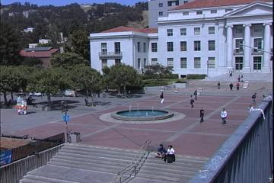

Slight Detour:
Background Extraction
Problem: Given a sequence of images I(x,y,t), extract the stationary component, or the ‘background’ from them
Images:
Alyosha Efros

Slide 14

Image Stack
time
255
0
t
We can look at the set of images as a spatio-temporal volume
  Each line through time corresponds to a single pixel in space
  If camera is stationary, we can decompose the image as:
  i(x,y,t) = b(x,y) + f(x,y,t)
Images:
Alyosha Efros
  image static background dynamic foreground

Slide 15
Power of Median Image
  i(x,y,t) = b(x,y) + f(x,y,t)
  image static background dynamic foreground
Key Observation: If for each pixel (x,y), f(x,y,t) = 0 ‘most of the times’
then
b(x,y) = median_{t} i(x,y,t)
Example: b(x,y) = 42; f(x,y,t) = [0, 2, 3, 0, 0]; i(x,y,t) = [42, 44, 45, 42, 42]
b(x,y) = median( [42,44,45,42,42]) = 42 !

Slide 16
Power of Median Image

Slide 17

Power of Median Image
Median Image =
Background !

Slide 18
Background Extraction & Intrinsic Images
Intrinsic Image Equation
I(x,y,t) = L(x,y,t) * R(x,y)
i(x,y,t) = l(x,y,t) + r(x,y) (log)
Compare to i(x,y,t) = f(x,y,t) + b(x,y)
Static Background = Reflection Image
Moving Foregrounds = Illumination Images
(shadows)

Slide 19
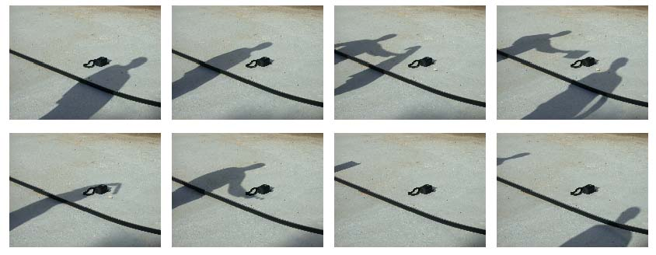
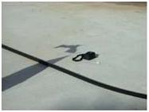
Trouble!
Illumination Images, l(x,y,t) sparse: Not a safe assumption
Median Image
“Shady” Result

Slide 20
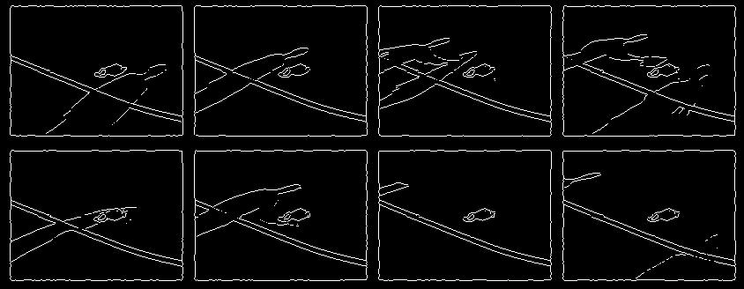
Key Idea:
Lets look at gradient images…
Gradients of shadows are sparse, even though the shadows aren’t !
Rationale: Smoothness of shadows

Slide 21
Key Idea:
Lets look at gradient images…
Gradients of shadows are sparse, even though the shadows aren’t !
Rationale: Smoothness of shadows
i(x,y,t) = l(x,y,t) + r(x,y) ^{gradient} i_{f}(x,y,t) = l_{f}(x,y,t) + r_{f}(x,y)

Slide 22
Key Idea:
Lets look at gradient images…
l_{f}(x,y,t) is sparse
r_{f}(x,y) = median_{t} i_{f}(x,y,t)
Gradients of shadows are sparse, even though the shadows aren’t !
Rationale: Smoothness of shadows
i(x,y,t) = l(x,y,t) + r(x,y) ^{gradient} i_{f}(x,y,t) = l_{f}(x,y,t) + r_{f}(x,y)

Slide 23
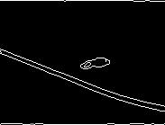
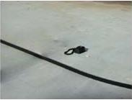
Median Gradient Image
r_{f}(x,y) = median_{t} i_{f}(x,y,t)
Filtered Reflectance image
Recovered Reflectance image

Slide 24
Median Gradient Image
Filtered Reflectance image
Recovered Reflectance image

Slide 25
Median Gradient Image
I(x,y,t) = R(x,y) * L(x,y,t)
T equations, T+1 unknowns
Still an Ill-Posed Problem ?
No, sparsity of
gradient illumination images
imposes additional constraints!
Filtered Reflectance image
Recovered Reflectance image

Slide 26




Recovering image from Gradient Images
(del operator)
f = v
➔ f = . v
v = (v₁,v₂)
Horizontal filtered image (v₁)
Vertical filtered image (v₂)
f(x,y)
Poisson Equation: f = g (from gradient images: g = .v)
Along with the boundary condition

Slide 27
Recovering image from Gradient Images
Interpretation of solving the Poisson equation:
Computes the function (f) whose
gradient is the closest to the guidance vector field (v),
under given boundary conditions.
(del operator)
f = v
➔ f = . v
v = (v₁,v₂)
Horizontal filtered image (v₁)
Vertical filtered image (v₂)
f(x,y)
Poisson Equation: f = g (from gradient images: g = .v)
Along with the boundary coundition

Slide 28
Recovering image from Gradient Images
Boundary can be from mean of input images –
hope that edges are mostly shadow-free
(del operator)
f = v
➔ f = . v
v = (v₁,v₂)
Horizontal filtered image (v₁)
Vertical filtered image (v₂)
f(x,y)
Poisson Equation: f = g (from gradient images: g = .v)
+

Slide 29
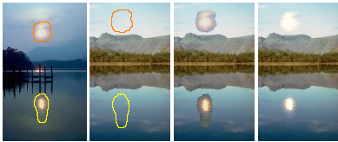
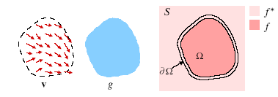
Poisson Image Editing
(Perez, Gangnet, Blake, SIGGRAPH ’03)
Source
Destination
Cloning
Poisson Blending
Want to find a new function f, which ‘looks like’ g in the interior and like f* near the boundary
➔ Use g as guiding vector field with f* providing the boundary condition

Slide 30
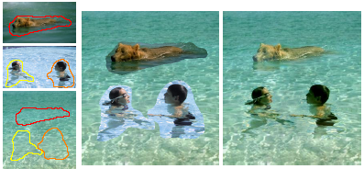
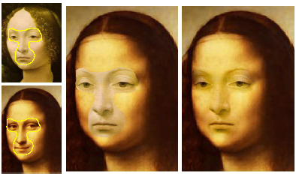
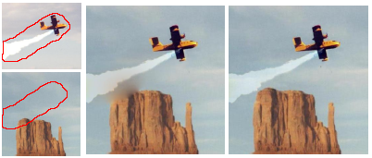
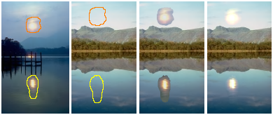
Poisson Image Editing
(Perez, Gangnet, Blake, SIGGRAPH ’03)

Slide 31
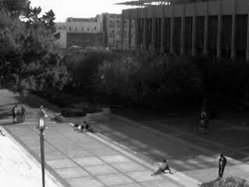
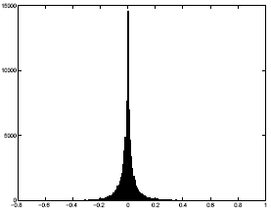
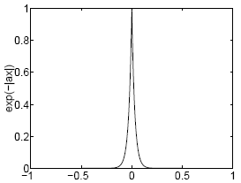
Spatial Structure: Impose Priors
Additional constraints required to make the problem tractable
Idea: Statistics of natural images → sparse derivative filter outputs
Input Image
Derivative filter outputs
Laplacian distribution
P(x) ~ e^{-α|x|} → MLE value of x is 0

Slide 32
Spatial Structure: Impose Priors
Additional constraints required to make the problem tractable
Idea: Statistics of natural images → sparse derivative filter outputs
Spatial Structure
Imposes more constraints
to make the problem tractable !!
Input Image
Derivative filter outputs
Laplacian distribution
P(x) ~ e^{-α|x|} → MLE value of x is 0

Slide 33
The Solution
N Filters {f_{n}}, filter outputs o_{n} = i * f_{n}
Claim: r_{n}(x,y) = median_{t} o_{n} (x,y,t)
Proof Sketch:
l_{n}(x,y,t) = i_{n}(x,y,t) – r_{n}(x,y) ( log images) …
Σ_{t} | l_{n}(x,y,t)| = 0 ( MLE estimate of laplacian distributed variable)
Σ_{t} | i_{n}(x,y,t) – r_{n}(x,y) | = 0
➔ r_{n}(x,y) = median_{t} o_{n} (x,y,t)

Slide 34
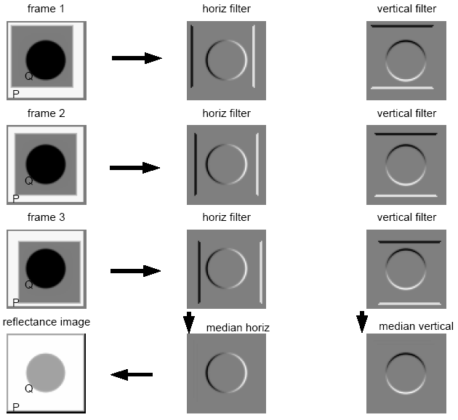
The Algorithm
Filter outputs for input image (o_{n}) are calculated
Filtered reflectance image (r_{n}) is computed as r_{n}(x,y) = median_{t} o_{n} (x,y,t)
Reflectance image r is recovered from r_{n}
Illumination images are recovered using the relation: l(x,y,t) = i(x,y,t) – r(x,y)

Slide 35
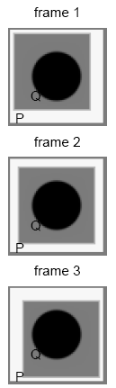
Question: Why filter?
Basic Assumption: l_{n} (x,y,t) follows a laplacian distribution ( is sparse)
Reasonable for natural images
Taking median of unfiltered images requires l(x,y,t) (unfiltered illumination images) to be sparse
This assumption is not valid for most of the cases
Unfiltered images → P,Q have different reflectance
Filtered images → Same reflectance

Slide 36




Results : Synthetic
frame i
frame j
ML reflectance
ML illumination (frame i)
** Note that the pixels surrounding the diamond are always in shadow, yet their estimated reflectance is the same as that of pixels that were always in light.

Slide 37
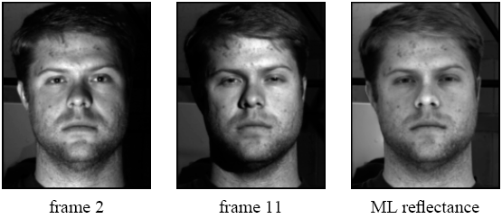
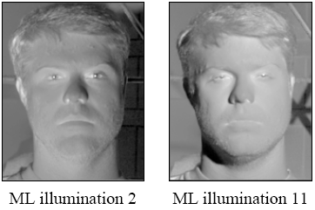
Results : Real World

Slide 38
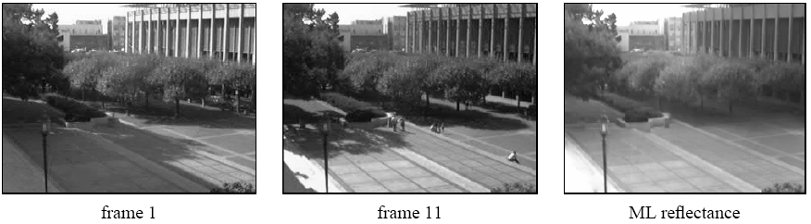
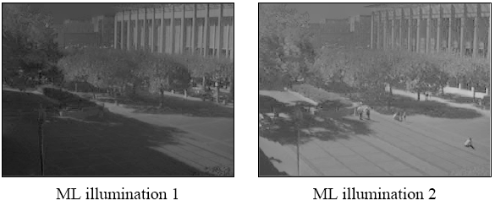
Results : Real World

Slide 39
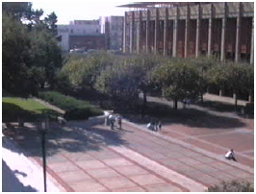

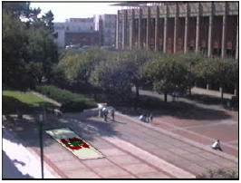
Some fun …
Original Image
Logo belnded with Image
Logo blended with reflectance image, and rendered with corresponding illumination image

Slide 40
Limitations
Requires multiple images of a static scene in different lighting
Highly sensitive to input - scene content and sequence length (basically a shadow detector !)
Can't remove static shadows
High complexity - filtering the images and finding median are high cost functions.

Slide 41
Conclusions
Fully automatic algorithm to derive intrinsic images from a sequence of images
Simplification by making constant reflectance assumption
Use sparsity of gradient images to derive a simple solution
  Paper has a rather complex statistical derivation for the same result !
Doesn’t tackle the original problem of recovering intrinsic images from a single image ( next presentation)

